Slide 1
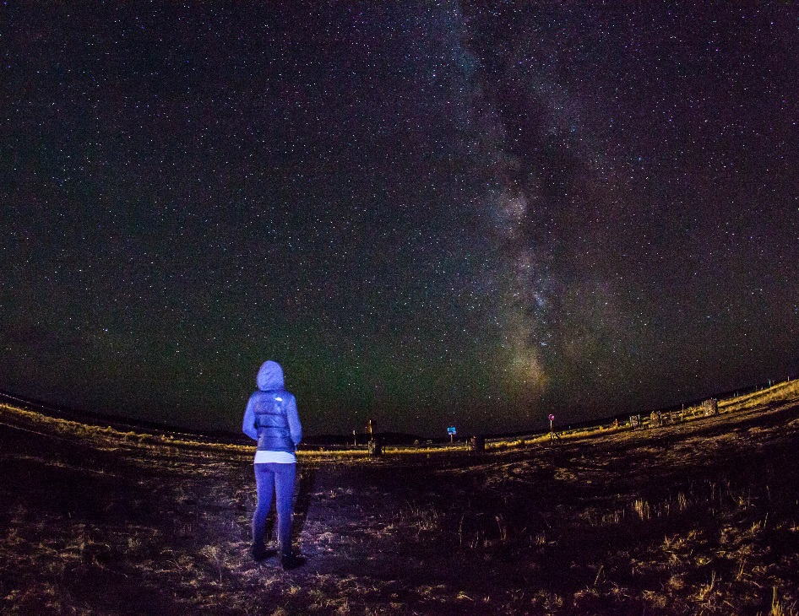
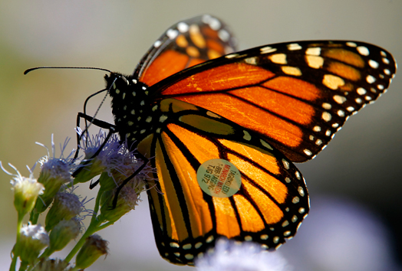
Monarchs, Minke Whales, Marbled Murrelets, and the Milky Way: How you can contribute to our understanding of the natural world through citizen science
Laura Guderyahn
Northwest Ecological Research Institute
A monarch butterfly with ID tag
Citizen scientist studying the Milky Way

Slide 2
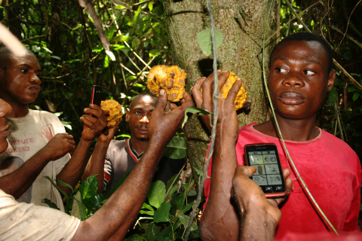
What is Citizen Science?
Public involvement in inquiry and discovery of new scientific knowledge
A project can involve one person or millions of people collaborating towards a common goal.
While adding value, volunteers acquire new learning and skills, and deeper understanding of the scientific work.
The fields that citizen science advances are diverse: ecology, astronomy, medicine, computer science, statistics, psychology, genetics, engineering and many more.
A group of men in the Congo geo-tag a fruit tree.
High school students document use of nesting boxes by local birds.
Notes:
The massive collaborations that can occur through citizen science allow investigations at continental and global scales and across decades--leading to discovery that a single scientist could never achieve on their own.
Help the USGS measure and record earthquake tremors
Join NASA's effort in counting passing meteors
Monitor noise and light pollution in our communities
Share photos and observations of wildlife and nature in your own backyard

Slide 3
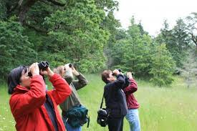
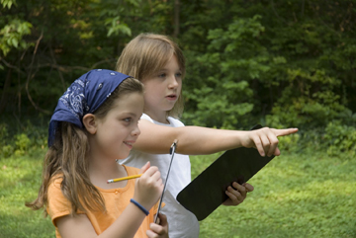
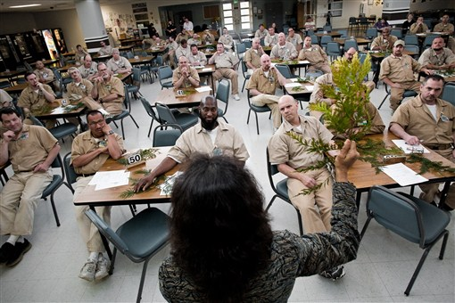
What does a citizen scientist look like?
A citizen scientist voluntarily contributes their time, effort, and resources toward scientific research - a formal science background is not required.
Citizen scientists come from all walks of life - retirees, environmental justice advocates, and even prisoners are getting involved.
Citizen science may be performed by individuals, teams, or networks of volunteers.
Prisoners learn to identify plants they will grow in their greenhouse.

Slide 4
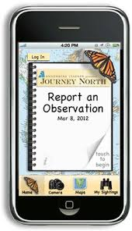
Where did the idea of Citizen Science come from?
Pre-20th century - science was usually the pursuit of those with money - gentleman scientists and amateur or self-funded researchers such as Sir Isaac Newton, Benjamin Franklin, and Charles Darwin.
Mid-20th century - science was dominated by researchers employed by universities and government research laboratories.
By the 1970s, concern over bureaucracy and bias led to advocacy for “a return to science by nature-loving amateurs instead of money-biased technical bureaucrats”.
With modern technology and the advent of smart phones, anyone can collect and contribute data all with the touch of a finger.
Notes:
"Citizen science" is a fairly new term but an old practice.

Slide 5
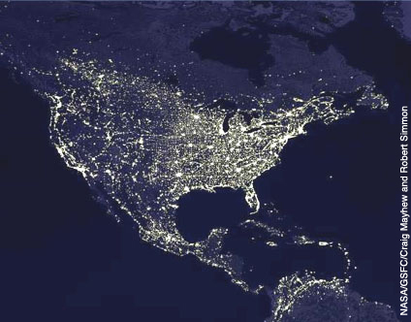
How is Citizen Science being used to advance scientific research?
Many citizen-science projects serve education and outreach goals. People can gain a deeper understanding of a scientific issue or question while contributing valuable data.
Bridging gaps. Connecting people to projects that are meaningful to them.
Scope. Thousands of can remotely contribute to a study and provide, analyze, or report data that researchers can use.
Policy. Increased public participation in scientific research will ideally cultivate a citizenship that is informed and willing to play a valuable role in influencing larger decisions about science policy.
Thousands of volunteers around the country help researchers study the effects of light pollution on wildlife.

Slide 6
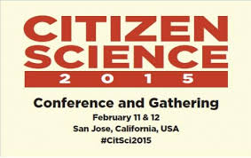
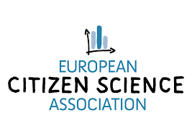
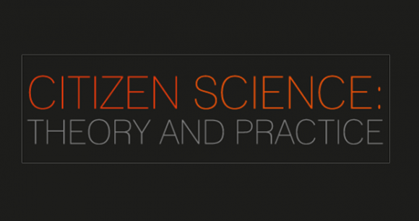
How is the field of Citizen Science being formalized?
Studies showing data from volunteers are as reliable as from professionals.
Professional Association – Citizen Science Association (www.citizenscience.org)
Professional Conferences:
Bi-annual citizen cyberscience summit in Geneva since 2010.
Public Participation in Scientific Research Conference (Portland, OR August 2012)
In January 2015, the University of Zurich international meeting on the "Challenges and Opportunities in Citizen Science".
The first conference of the Citizen Science Association was held in San Jose, CA in February 2015.
Peer-reviewed Journal – Citizen Science: Theory and Practice
Citizen Science graduate course: Graduate level courses at Arizona State University, Florida State University,
Champions of Change: In 2013 the White House honored several "stellar" citizen scientists.
Mobile technology has further boosted the opportunities for citizen science through interactive web pages, mobile phone apps and networking opportunities.

Slide 7
So what kinds of projects are citizen scientists involved in???

Slide 8
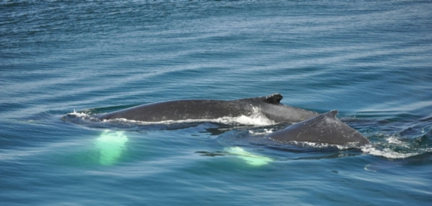
Humpback Tails Wanted!
CARIB Tails is enlisting yachters and cruisers to help track the movements of humpback whales between their North Atlantic feeding grounds and their breeding grounds in the Wider Caribbean Region.
Citizen scientists photograph the distinct patterns on the tails of humpback whales in their Caribbean breeding grounds.
All that is needed is a camera and knowledge of safe boating around whales.

Slide 9
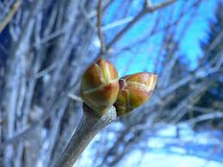
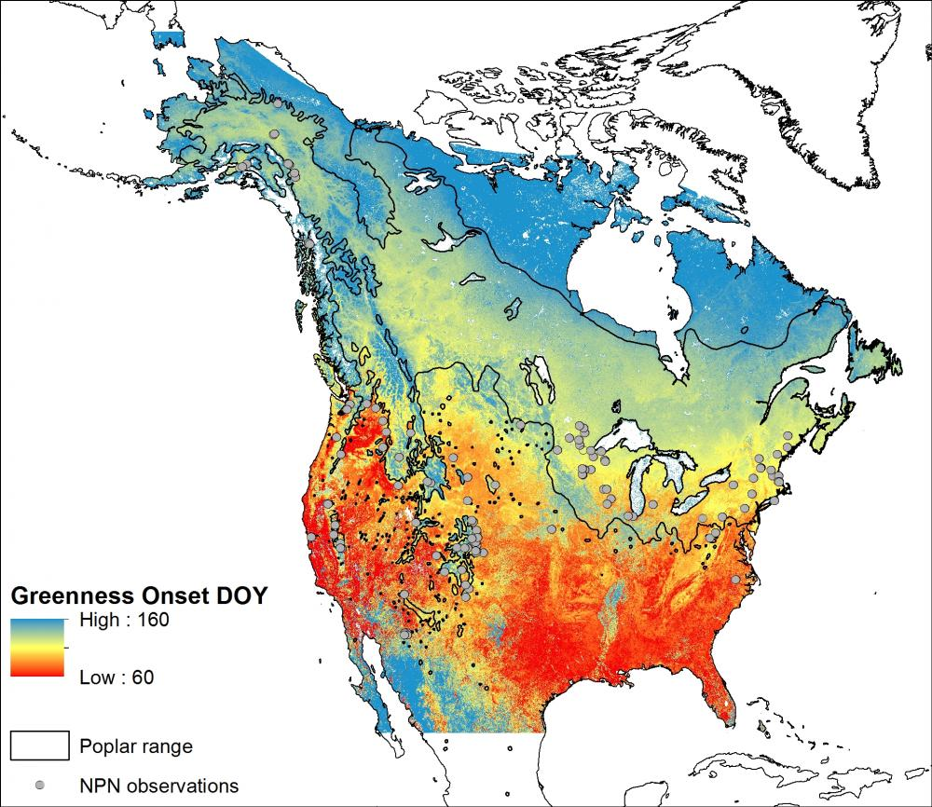
Nature’s Calendar and Project Bud Break
Natures Calendar
Study in the UK - record seasonal events like the first flowers opening on bluebells, the first blue tits collecting materials to build their nests, or the first autumn colours to appear on the trees.
Project Bud Break
New York - observe the timing of flowering, leaf development, fruiting, and leaf drop in populations of trees and herbaceous plants.
Both projects monitor effects of global climate change on native plants.

Slide 10
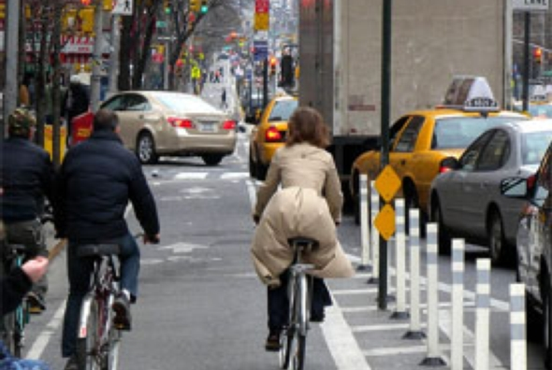
NYC Cyclist Air Study
NYC cyclists can help Columbia University researchers study air pollution on the streets
How much air pollution are New Yorkers are exposed to as they ride their bikes in the city, and how does this exposure affects their hearts.
Study participants wear air pollution monitors, a special shirt that monitors their heart rates, and an automatic blood pressure cuff for five 24-hour periods centered around five morning bike commutes.

Slide 11
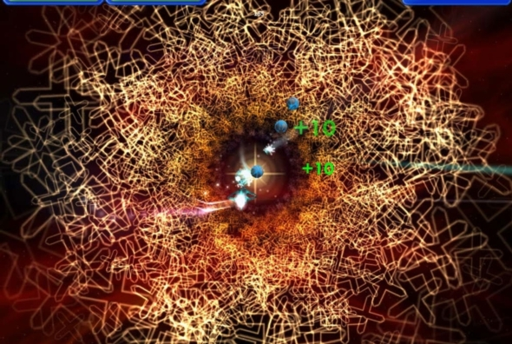
DARPA Verigames Crowdsourced Formal Verification (CSFV) project
Citizen scientists help software developers detect flaws that make their programs vulnerable to hackers
Citizen scientists can effectively do the work of formal verification experts—simply by playing and completing games.
The games are created to assist in the formal verification process as players solve puzzles and increase their score.
Video games that represent the underlying mathematical concepts allow more people to perform verification analysis of software efficiently.

Slide 12
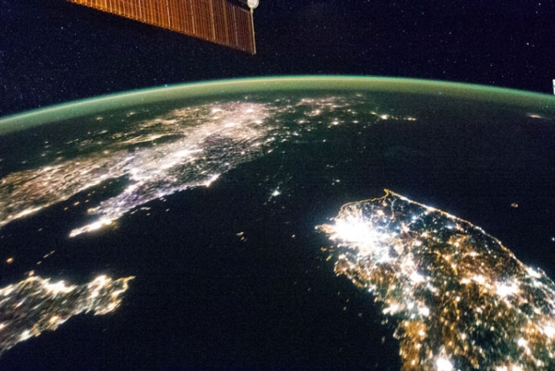
Lost at Night
Help astrophysicists georeference the position of cities which appear in images taken from the International Space Station (ISS)
Researchers in Madrid are studying light pollution and the energy consumption derived from it.
Citizen scientists compare night images taken from the ISS and try to identify the city. Citizen scientists have some simple tools at their disposal, including zooming in and out, dragging, and rotating the image. When a picture is identified, the citizen scientist clicks on the map to mark its position.

Slide 13
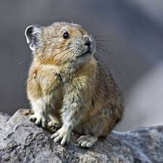
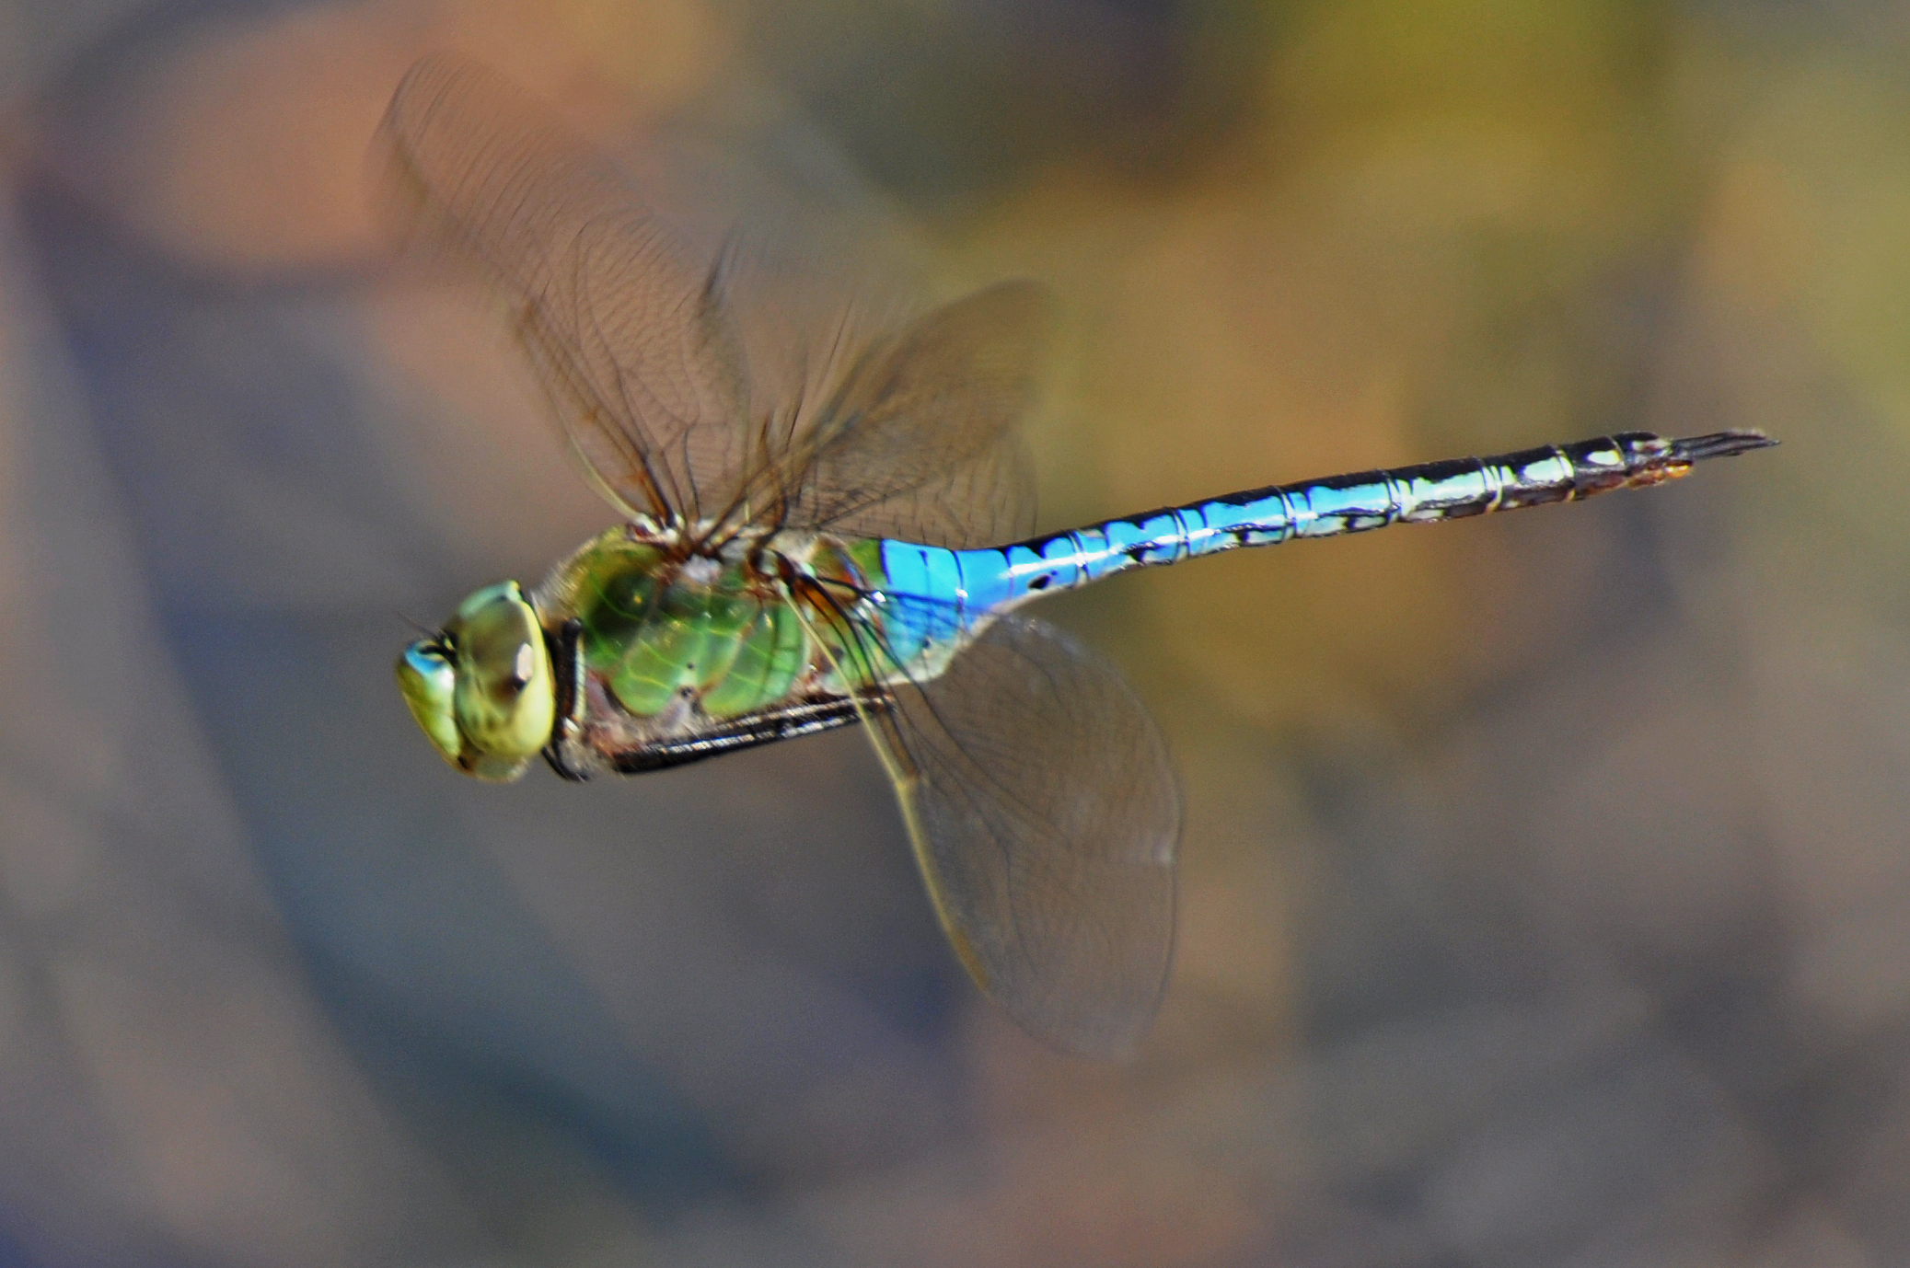
Opportunities Closer to Home
Projects in the Portland-METRO region:
Track “rare” species
ID invading plants and animals
Track changes in diversity and populations over time
Track disease/malformations in frogs
All this information is used to:
Prioritize land acquisition and management activities
Inform management, resource allocation, policy and planning

Slide 14
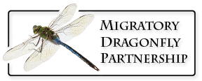
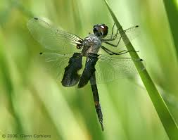
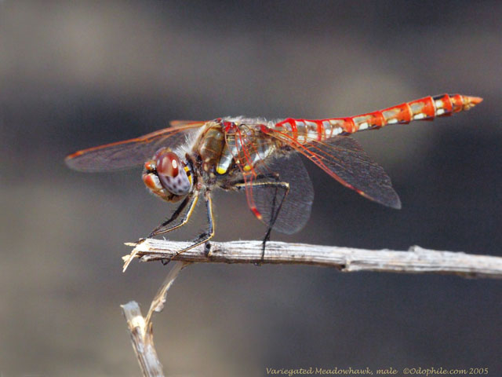
Migratory Dragonfly Project
To better understand and conserve spring and fall movement of the five best-known migratory dragonflies in North America:
Common Green Darner (Anax junius)
Black Saddlebags (Tramea lacerata)
Wandering Glider (Pantala flavescens)
Spot-winged Glider (Pantala hymenaea)
Variegated Meadowhawk (Sympetrum corruptum).
Partnership of researchers and citizen scientists across Canada, Mexico, and the United States
Participants monitor the timing, duration, and direction of travel of migrating dragonflies, and note any additional behaviors observed in a directed migratory flight such as feeding or mating.
http://www.migratorydragonflypartnership.org/index/welcome
Black Saddlebags (Tramea lacerata)
Variegated Meadowhawk (Sympetrum corruptum)

Slide 15
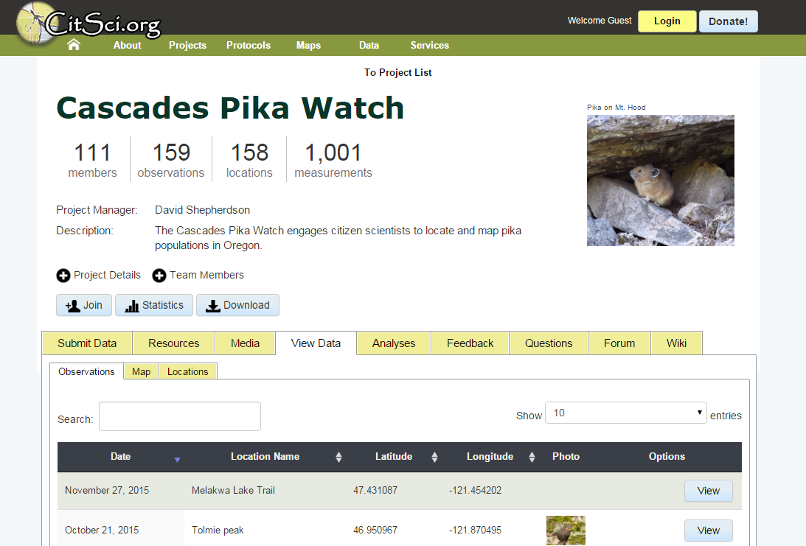
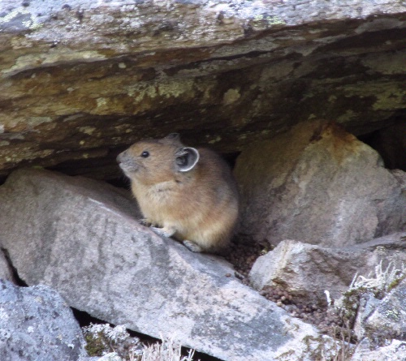
Cascade Pika Watch
American pikas are considered to be sensitive indicators of climate change due to their extreme heat sensitivity and limited dispersal ability.
The Cascades are home to one of the five subspecies of pika, but no long-term monitoring or historical resurveys have been conducted for pikas in the region.
In Cascades Pika Watch, volunteers contribute data on pika sightings in the region and monitor a group of core sites in and around the Columbia River Gorge and Mt Hood NF.
http://www.oregonzoo.org/cascades-pika-watch

Slide 16
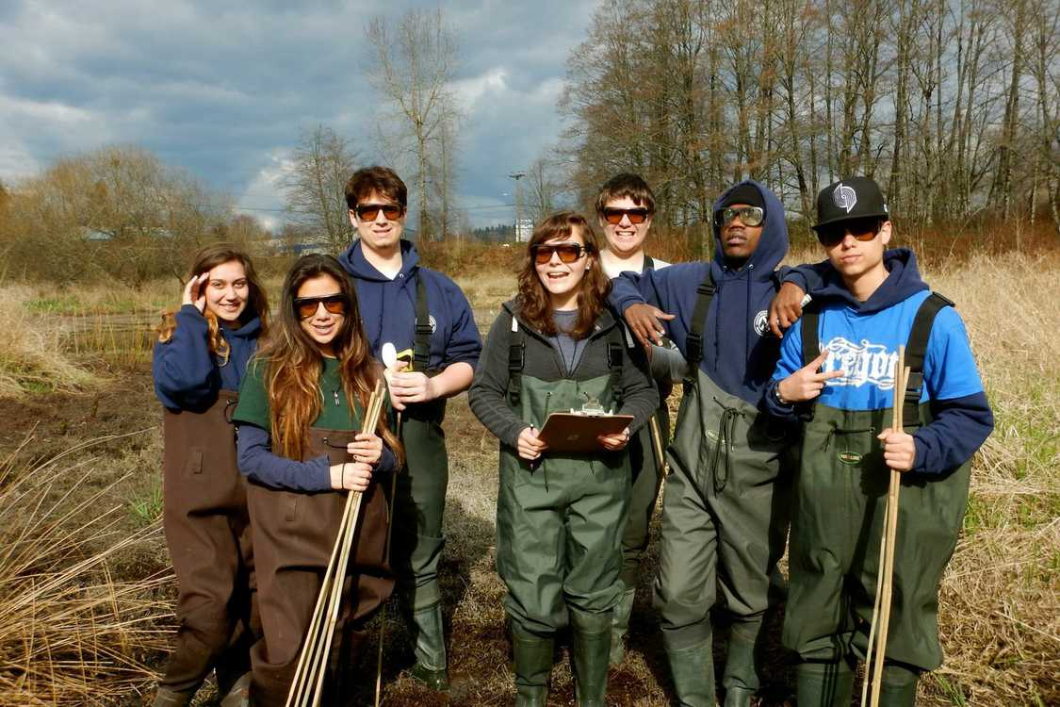
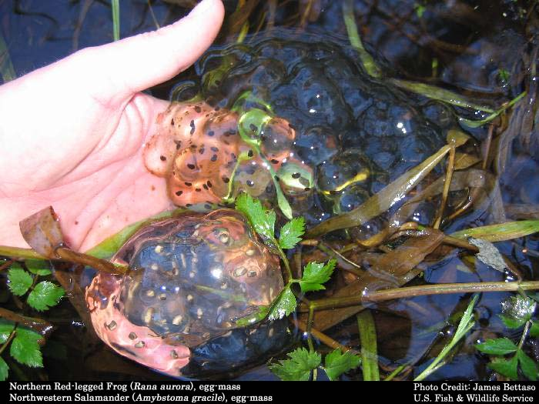
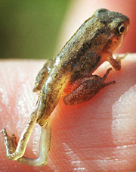
Amphibian Monitoring
Pull on waders, grab a spoon and a plastic bag and learn how to search for frog and salamander egg masses, larvae and adults!
Multiple jurisdictions and non-profits are working to document population trends for our local amphibian species:
METRO
NERI – SWAMP (SW Washington Amphibian Monitoring Program)
Hillsboro
Gresham
Critter Count – April 9th, 2016 (Vancouver Water Resources Education Center)
Through this effort we are tracking species diversity, trends and disease/malformations

Slide 17
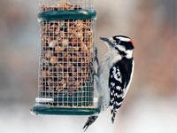
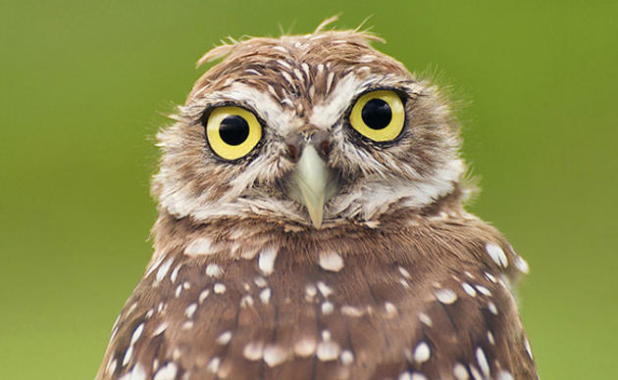
Bird Surveys
Through Cornell Lab of Ornithology and National Audubon Society
eBird - innovative online tools for birders to keep track of and contribute their bird sightings for use in science and conservation.
Project Feeder Watch - Each year, 15,000 people count birds at their feeders; with more than 1.5 million checklists submitted since 1987, volunteers are enabling scientists to monitor changes in the distribution and abundance of birds.
Nest Watch - By finding and monitoring bird nests, NestWatch participants help scientists track the breeding success of birds across North America.
Christmas Bird Counts - Audubon Society's Christmas Bird Count began in 1900!; Volunteers follow specified routes through a 15-mile wide diameter circle, counting every bird they see or hear all day.
Great Backyard Bird Count - Begun in 1998, the four-day Great Backyard Bird Count was the first citizen-science program to collect and display bird observation data online on a large scale. This year = Feb 12-16, 2016.
http://www.birds.cornell.edu/page.aspx?pid=1664
https://www.audubon.org/
Notes:
21 people found 111 species

Slide 18
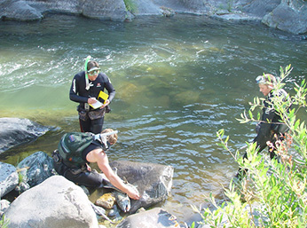
Adult Salmon Spawner Surveys
Oregon and Washington Departments of Fish and Wildlife.
Trained volunteers walk streams and rivers to count the live and dead salmon, as well as salmon redds (nests)
Volunteers also collect scale and tissue samples from the salmon carcasses. Scale samples are used to determine age, the otolith (ear bone) are used to identify age and origin, and tissue samples are used for DNA analysis.
Snorkeling is another method of surveying rivers and streams to count returning adult salmon. Trained volunteers snorkel certain areas to count live and dead fish and to collect carcasses for sampling.
This information is provided to biologists as another tool for managing the fisheries resource.
http://pnwsalmoncenter.org/research/salmon-monitoring/

Slide 19
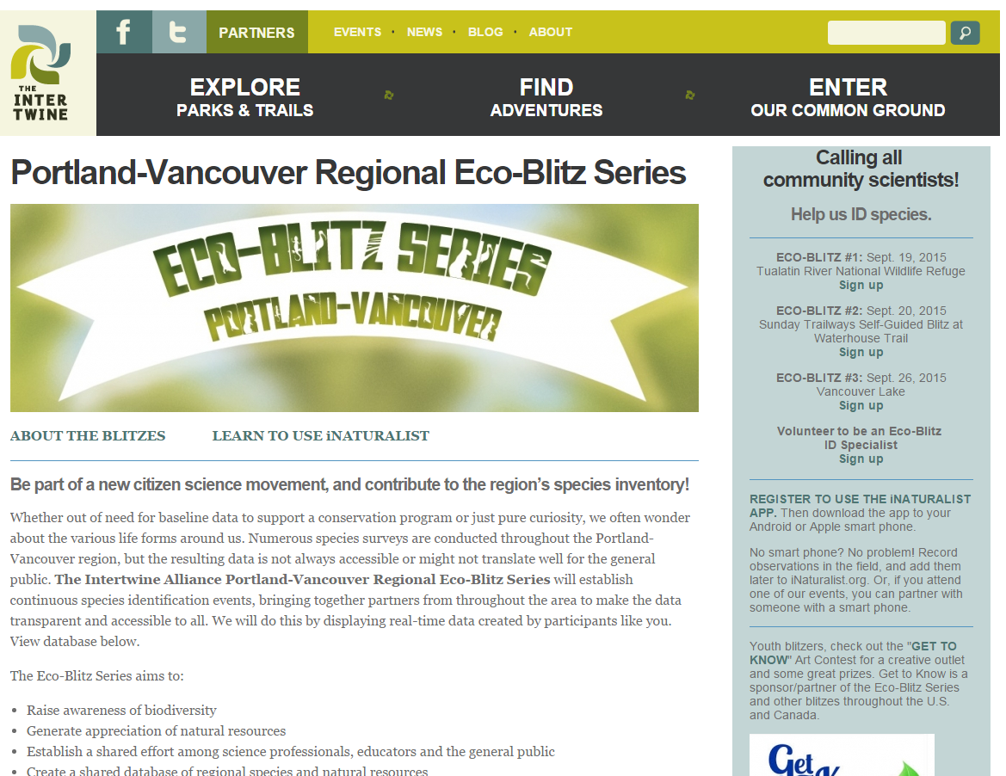
BioBlitz
Bioblitz - finding and identifying as many species as possible in a specific area over a short period of time, usually 24-48 hours
Blitzes have been held in dozens of countries, involving hundreds of thousands of people around the world.
National Park Service hosting hundreds of Blitzes across the country to celebrate the NPS Centennial in 2016.
April 2nd – Metro – Graham Oaks Nature Park
April 9th – Critter Count – City of Vancouver
April 23rd – Sandy River Delta
May 21st – Fort Vancouver
May 21st – City of Portland and Johnson Creek
Watershed Council - Powell Butte
http://theintertwine.org/blitz

Slide 20
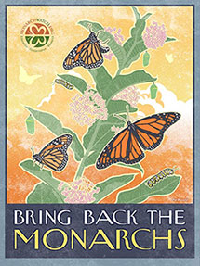
How can you get involved?
Join a local effort!
If you aren’t from around here:
https://www.scientificamerican.com/citizen-science/
http://www.citizensciencealliance.org/projects.html
https://www.nwf.org/Wildlife/Wildlife-Conservation/Citizen-Science.aspx
If you are a Birder: http://ebird.org/content/ebird/about/
Great Backyard Bird Count Feb 12-16, 2016!
Star Gazer: http://www.windows2universe.org/citizen_science/starcount/index.html
A frogger: https://www.aza.org/frogwatch/
Monarch Mayhem: http://www.monarchwatch.org/
And much, much more…☺

